Slide 1

SilQ - QCodes
A new era begins…

Slide 2

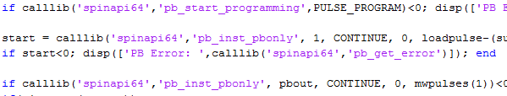
Why?
Need to free ourselves from the rule of bad very task specific coding

Slide 3


Slide 4

Python
Basic differences
Tabs
No semicolons
imports
https://docs.python.org/2/tutorial/

Slide 5
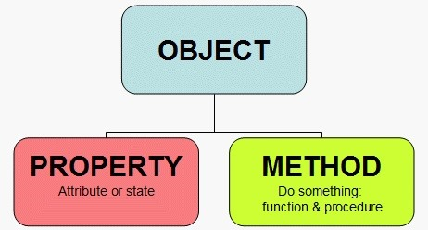
Object oriented programming

Slide 6
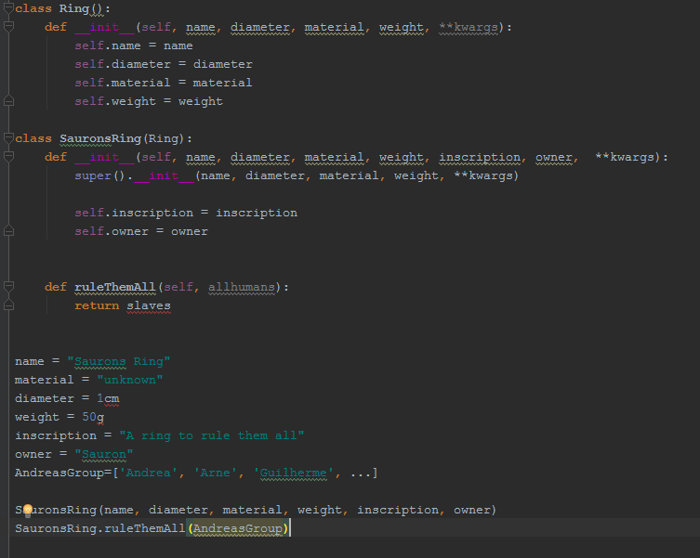


SuperClass
Class
Properties
Initialization
Properties
Method
Instance

Slide 7
Silq and QCodes

Slide 8



The interpreters

Slide 9
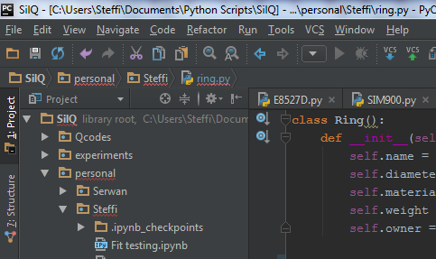
PyCharm
if __name__ == "__main__": ATS = ATS_driver.ATS9440('ATS', server_name='Alazar_server')

Slide 10
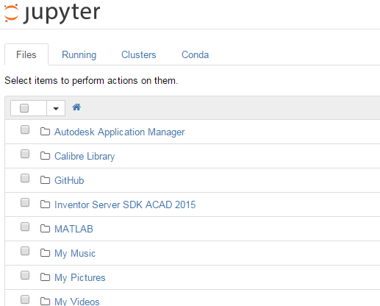

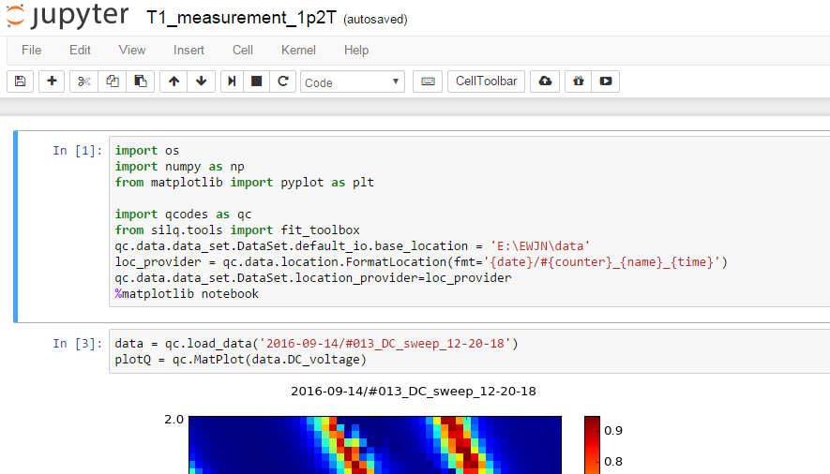
Notebook
Jupyter

Slide 11
Real time measurement
Hosted on server accessible with vpn connection from everywhere
http://129.94.115.27:8889/

Slide 12

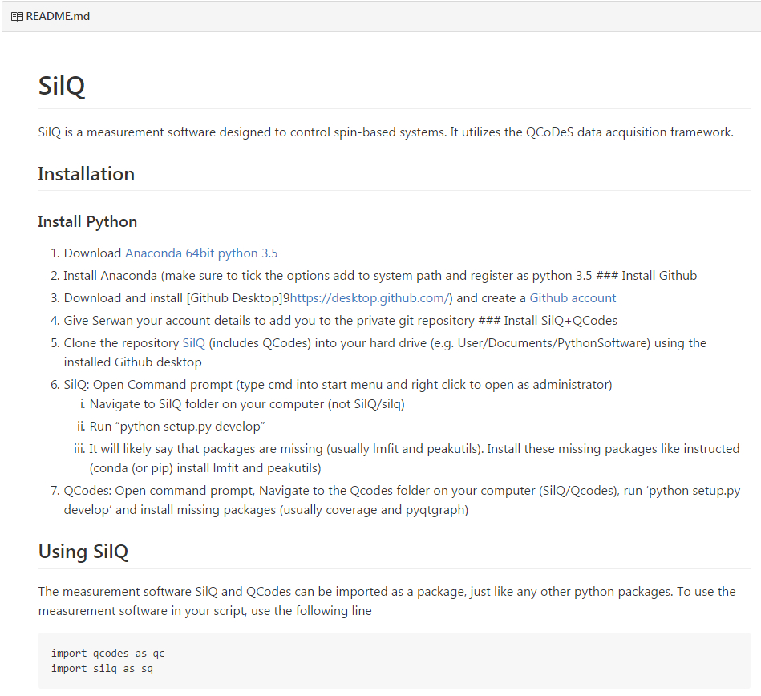
Installation
Description on the github page (https://github.com/nulinspiratie/SilQ) and Readme.md document

Slide 13


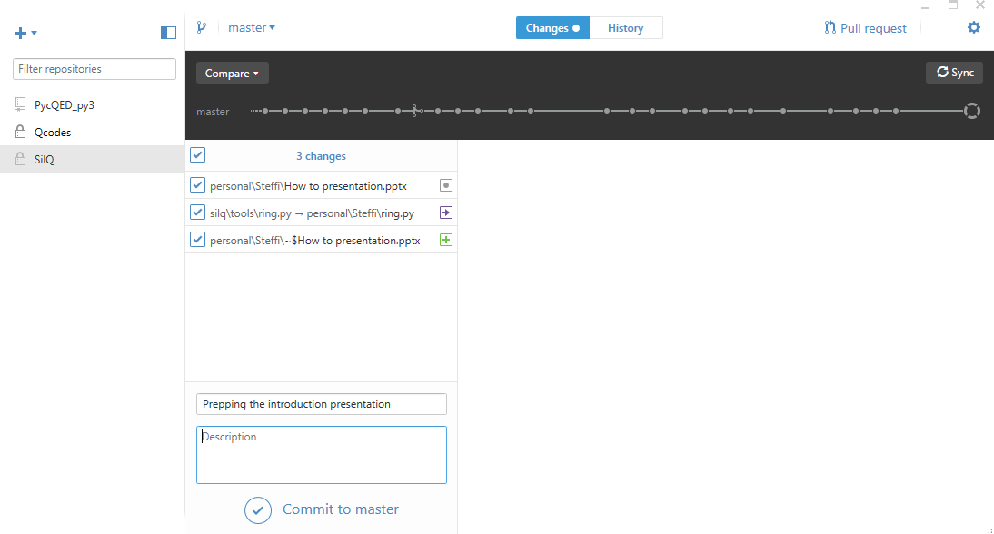
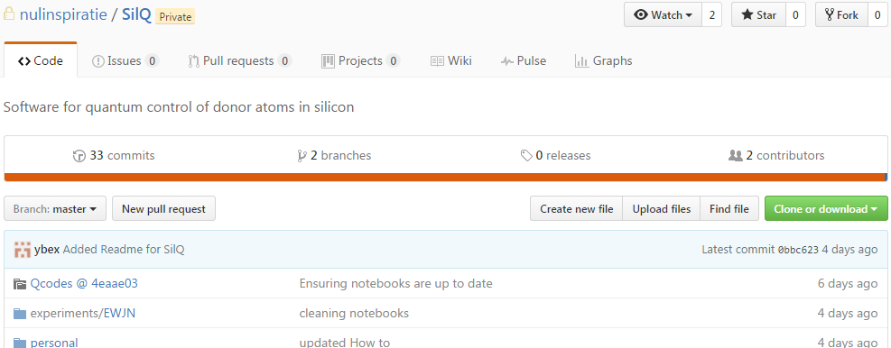
github
Github online

Slide 14


Coding rules
Python
https://www.python.org/dev/peps/pep-0008/#prescriptive-naming-conventions
Use 4 spaces per indentation level (use tabs)
imports on top of the file
Class names should normally use the CapWords convention
Function names should be lowercase, with words separated by underscores as necessary to improve readability
Always use self for the first argument to instance methods
__foo__: this is just a convention, a way for the Python system to use names that won't conflict with user names.
_foo: this is just a convention, a way for the programmer to indicate that the variable is private (E.g. from M import * does not import objects whose name starts with an underscore).
__foo: this has real meaning: the interpreter replaces this name with _classname__foo as a way to ensure that the name will not overlap with a similar name in another class.
foo = long_function_name(var_one, var_two,
var_three, var_four)
Us
No abbreviations
Write descriptive comments

Slide 15
The journey is not over yet…
Steering
Adding instrument drivers
ESR/NMR drive
GUIs
In–situ change of loops
…

